Slide 1

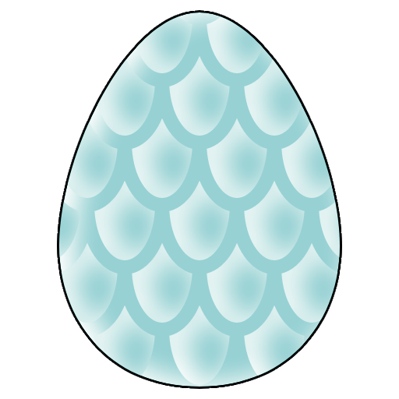
The Hatch Quest
By: Akın Kekikciler

Slide 2
Introduction & Concept

Slide 3
Project Overview
Core
Concept
Introducing a unique mechanic into a clicker game using external purchases through a PHP, HTML, and MySQL website.
Players click on dragon eggs to hatch them, with each egg having increasing health. To progress, players purchase upgrades via an external website

Slide 4
Game Mechanics

Slide 5
Gameplay
Loop
Available
Upgrades
Click on eggs to hatch them
↓
Earn gold with each click
↓
Use external website to buy upgrades if stuck on a level
Increased Click Damage
Auto-Click Damage
Critical Strike Chance
Gold Multiplier

Slide 6
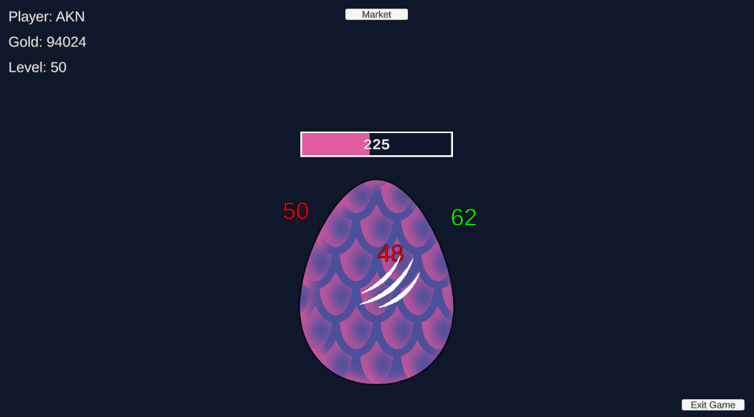

Slide 7
